Slide 1

Mitigating latency in serverless computing using aws lambda
Mehak Rajpal

Slide 2
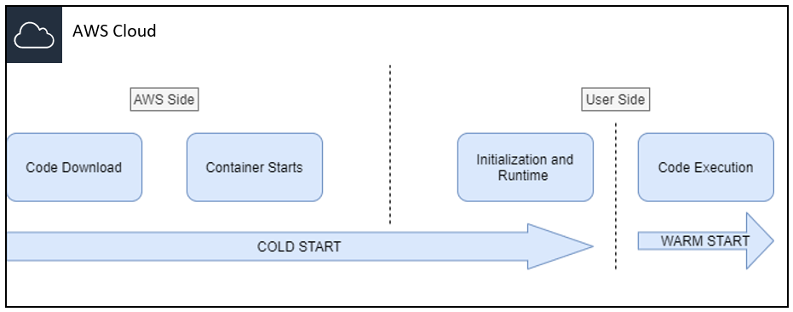
Research niche
Area: Serverless Computing
In the 2018 Serverless Community survey, developers quote cold start latency as the third biggest concern.
Problem: Cold start latency.
Competition: The cold start latencies in AWS were relatively stable, as were those in Google (except for a few spikes). Azure had the highest network variation over time, ranging from about 1.5 seconds up to 16 seconds.”
( https://jaxenter.com/comparison-aws-azure-google-147706.html )
Profitability: The offered approach will further reduce the initialisation time of the container. As it is a code-based approach, it can be used by any size of organisation irrespective of their workload.
Test: The approach will be presented on AWS and will be tested using the same amount of workload in two runs. One run will include the logic of proposed approach and the other will be just a simple initialisation of lambda function.
1. How the performance of serverless architecture be enhanced by reducing the latency involved
during function invocation through mitigating the cold start?

Slide 3
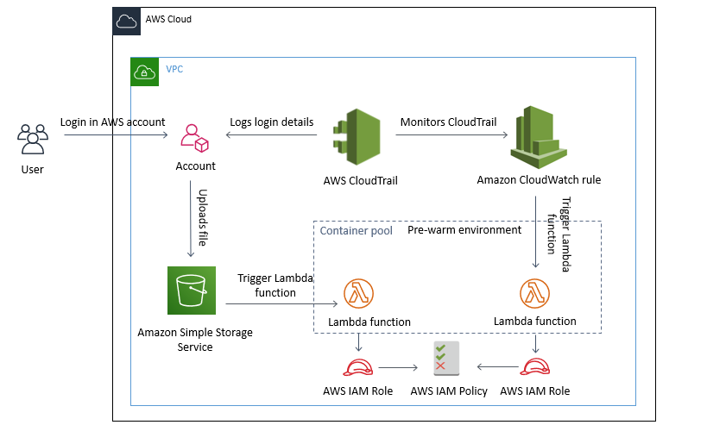
Proposed method and implementation
In my proposed method and implementation, I'll be using set of AWS triggers. The flow is as below.

Slide 4
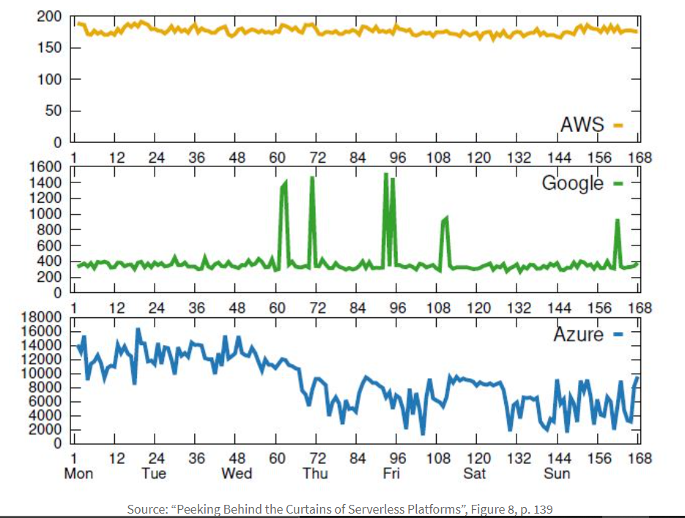
Comparison with other provider
Azure
Amazon
Azure allocates a preconfigured server from the pool of warm workers to your app. This server already has the Functions runtime running on it, but it is unspecialized.
This worker becomes specialized by configuring the Functions runtime in ways that are specific to your app.
https://azure.microsoft.com/en-us/blog/understanding-serverless-cold-start/
AWS offers Provisioned Concurrency, which allows more precise control over start-up latency when Lambda functions are invoked.
Provisioned Concurrency is designed to keep your functions initialized and hyper-ready to respond in double-digit milliseconds at the scale you need. Here the functions are ready to respond to requests.
This feature is ideal for where you need predictable function start time or schedule.
https://aws.amazon.com/blogs/compute/new-for-aws-lambda-predictable-start-up-times-with-provisioned-concurrency/
Additional to the tests described above, the research team “collected the coldstart latencies of 128 MB, Python 2.7 (AWS) or Nodejs 6.* (Google and Azure) based functions every 10 seconds for over 168 hours (7 days), and calculated the median of the coldstart latencies collected in a given hour.

Slide 5
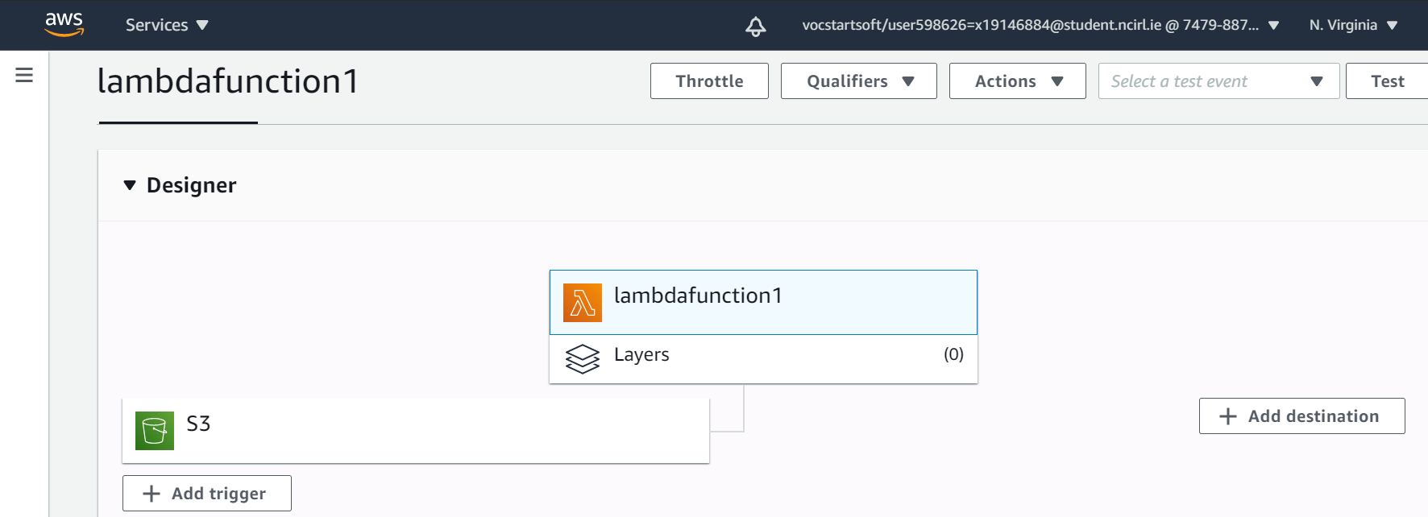
Research plan
After comparing AWS, Azure and GCP, I plan to go with AWS.
I tried to invoke a asynchronous lambda function in the adjacent figure.
Next steps:
Developing AWS lambda function on python and setting up the approach using triggers.
Adding different workloads and what processing will be performed on the data (creating data-set on my own).
Evaluating and comparing the results (CloudWatch, ).

Slide 6
Points highlighted in 1st meeting – 12/10/2020
Why AWS? Not openstack or openwhisk
Problem statement
Expense management?
Benchmark? (CloudWatch records the session logs and duration of lambda runtime, AWS X-ray)
Dataset generation – (generating manually)
What’s unique?

Slide 7
What my project includes
System level challenge:
Cold Start: Delay that only occurs during initial invocation as the infrastructure setup required for function provisioning has to established from scratch. This process involves downloading of code, starting the container and setting up the runtime environment which then allows code execution.
Unique deployment process setup with CloudWatch.
Programming model challenge:
Deployment: Developers should be able to use declarative approaches to control what is deployed and tools to support it.
Automating CloudTrail, CloudWatch and lambda as a single automated function via AWS Cloud Formation.
Research paper link: https://arxiv.org/pdf/1706.03178.pdf%20http://arxiv.org/abs/1706.03178.pdf page 14

Slide 8
Why AWS?
AWS
OpenWhisk
Have 5 papers backing up the cold-start issue in AWS lambda and other service providers.
The pricing can be managed as shown in the further slides.
By IBM
Cold-booting issue similar to Cold-start.
Do not have multiple resources backing up the cold-start issue in OpenWhisk. (only 1)
http://conferences.inf.ed.ac.uk/EuroDW2018/papers/eurodw18-Shillaker.pdf

Slide 9
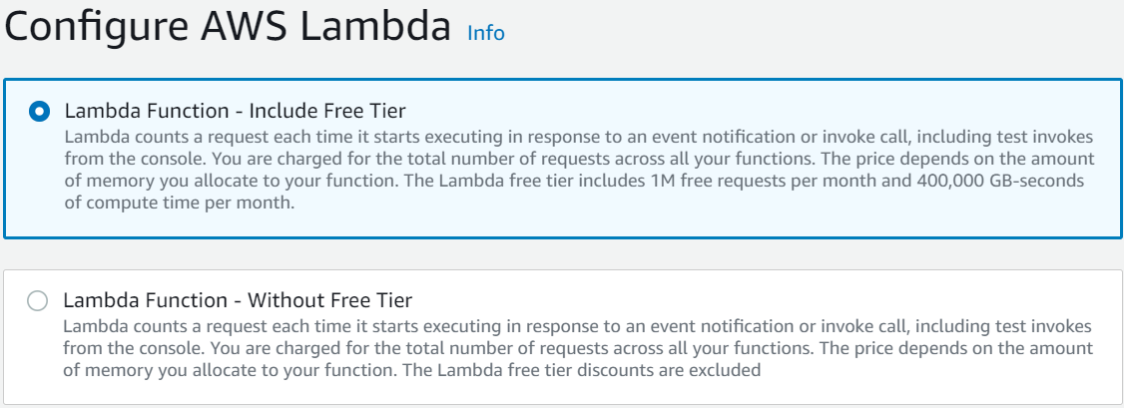
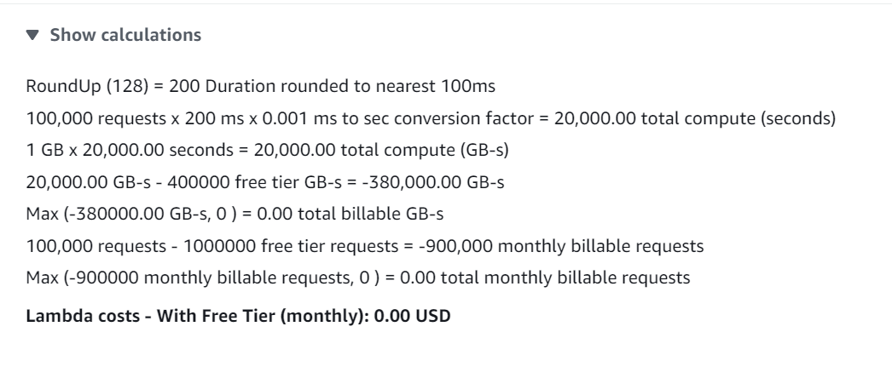
Factors on which the pricing depends- Lambda pricing model
Lambda is charged on the basis of requests.
Lambda Pricing: One Million free requests per month.
Duration calculated: From the time your code begins executing until it returns or otherwise terminate (No charge).
Memory allocation: charged
Data transfer charge: AWS Lambda functions in the same AWS Region is free.
Additional Charge: Storage - Billed for the read/write requests and the data stored in Amazon S3.
Calculator : https://aws.amazon.com/lambda/pricing/

Slide 10
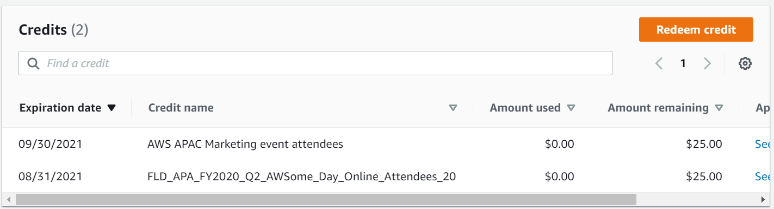
Pricing for other services
Cloud Watch: Free 10 custom metrics and 10 alarms.
Cloud Trail: Will be free as the first copy of management events is free, the charges will apply of S3 storage cost. We are not using CloudTrail insights.
Step function in AWS lambda: Free
AWS X-Ray: No upfront fees or commitments. Pay according to use, based on the number of traces recorded, retrieved, and scanned.
The first 100,000 traces recorded each month are free.
The first 1,000,000 traces retrieved or scanned each month are free.
AWS Cloud Formation: 1,000 free handler operation per month

Slide 11
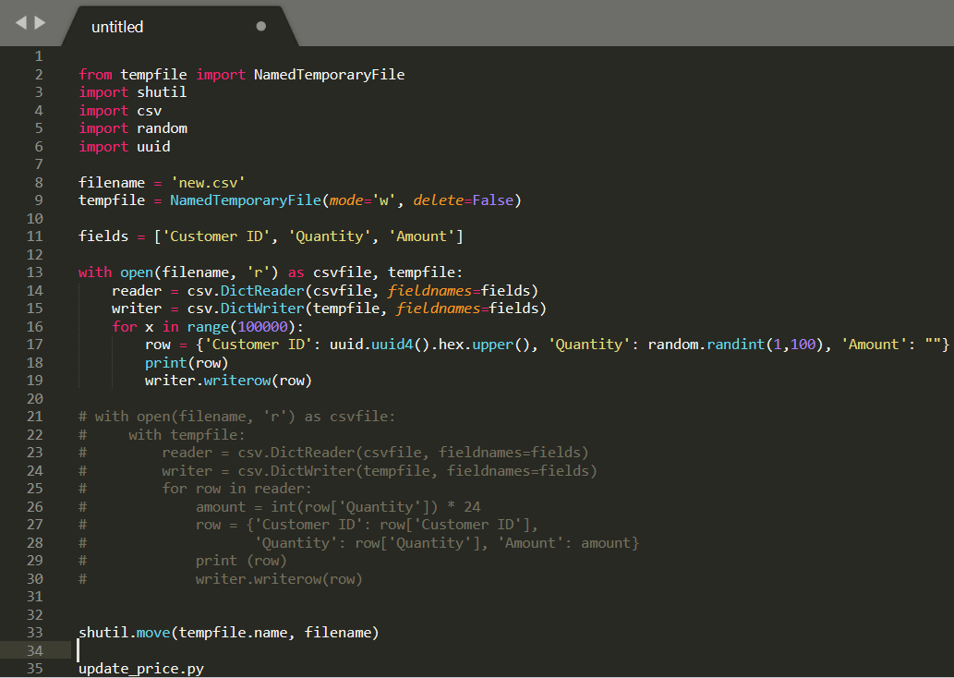
Data set generation/ function logic
Lambda function Pseudocode (local):
To generate the data set of customers with certain amount (tried in the local). 100,000 records.
Lambda will then update the amount with the changed record.

Slide 12
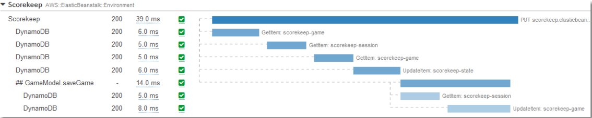
Benchmarking process
X-Ray SDK for Python – Python 2.7, Python 3.6, and newer runtimes.
Lambda will be integrated with X-ray benchmarking service.
Use Case: The SDK records data about incoming and outgoing requests and sends it to the X-Ray daemon, which relays the data in batches to X-Ray. For example, when your application calls DynamoDB to retrieve user information from a DynamoDB table, the X-Ray SDK records data from both the client request and the downstream call to DynamoDB.
Functioning: Here we are using X-Ray for benchmarking the test duration.
CloudWatch: Will measure Invocation and performance duration
Offerings : End to end tracing, supporting multiple languages, cross-service view of request made to your application.

Slide 13
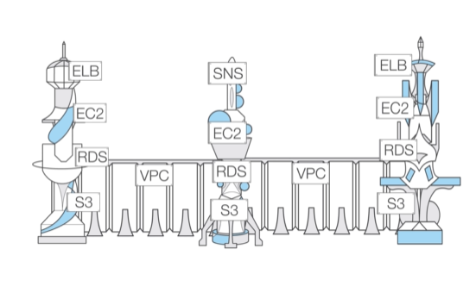
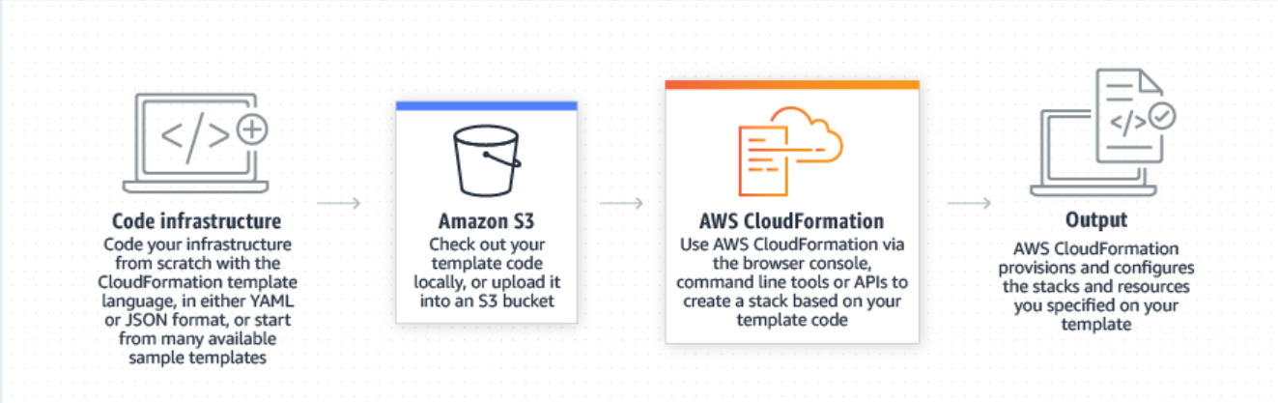
Uniqueness: The approach will be ‘coded’
AWS Cloud Formation: Infrastructure as a Code
AWS CloudFormation gives you an easy way to model a collection of related AWS and third-party resources, provision them quickly and consistently, and manage them throughout their lifecycles, by treating infrastructure as code.
Language: YAML, JSON.

Slide 14
High-level Execution PlaN
Create a new lambda function via lambda console.
Function code in python: what lambda will do?
Executing 1st time: will show the latency on the console. (e.g. it takes 2 second)
Executing the same function with defined approach: Takes only 1 second.
The comparison of both will highlight the cold start encountered during the initial function run.
Step function: Step Functions to coordinates multiple AWS Lambda functions in a serverless workflow .
Services communicate via API’s (boto3), so I have to write a code that will be integrated will all the API’s.
Add estimated timeout of function execution.
Check IAM > S3, X-ray policies
Add trigger configuration
CloudWatch Rule: Create rule: Schedule, target = lambda function name.
Cron expression: defining patterns
Lambda > selecting test (manual) > Test event (10 test limit) 6:27 (main code on 6:18:49)
Events : create an event and call in the lambda function.
(Lambda: where the actions is performed. Event: the action to be performed.)
Cloud Formation: Standard/import
Configure test events: Sample code will be pasted in test event.

